Slide 1
ML ALGORITHMS

Slide 2
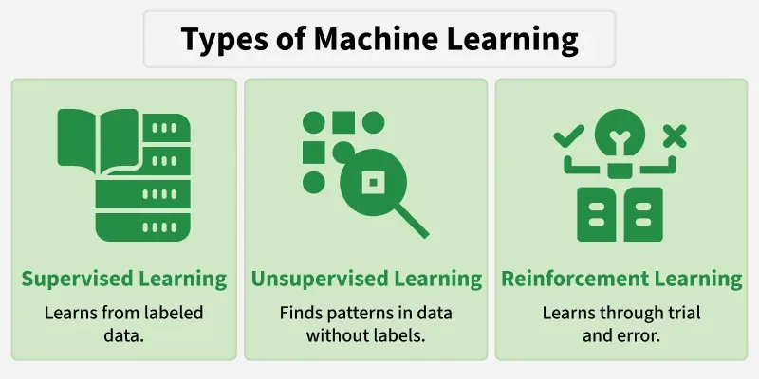

Slide 3
Machine Learning = Give data → Learn patterns → Make predictions

Slide 5
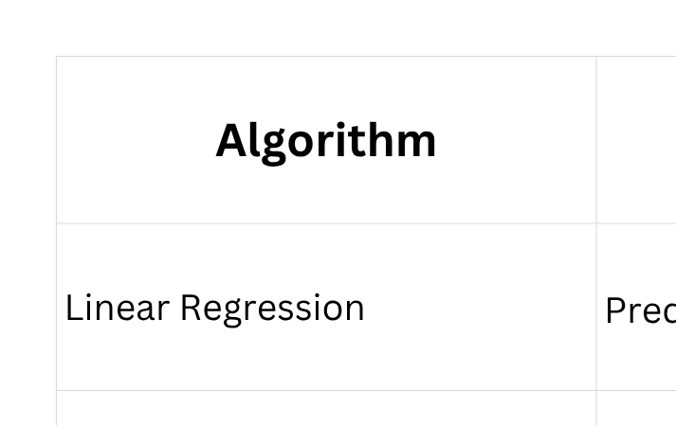

Slide 6
If a patient checks whether hes going to have heart disease is called classfication(binary)
but whether he could take insurance or not is Regression (how much i could pay)

Slide 7
Algorithm =
statistics distribution(EDA)
+ mathametical intuition +
dataset workout

Slide 8
Statistical Distribution
Binomial Distribution → coin ->head /tail
Bernouli Distribution → 10 time* Tossing
Geometric distribution → How many u should toss a coin to get head or tail

Slide 9
Linear Regression
  Supervised learning regression algorithm
  ip (x) vs op(y)
relationship between 2 values
  X independent variable
  y dependent variable/
predicted variable/ target vector

Slide 10
Linear Regression
Purpose: Predicts continuous numerical values (e.g., house prices, temperatures).
How it works: Fits a straight line (best-fit hyperplane) that minimizes the sum of squared differences between predicted and actual values.
Best used for: Continuous target variables with a linear relationship to features. [1, 2, 3]

Slide 11
Input → Model → Number
Example:
Hours studied → Exam score
If students study:
1 hour → 35
2 hours → 45
3 hours → 55
4 hours → 65
5 hours → 75
The model learns a relationship between hours and marks.
Then:
Student studies 5 hours → predict ~80 marks.
That's Linear Regression.

Slide 12
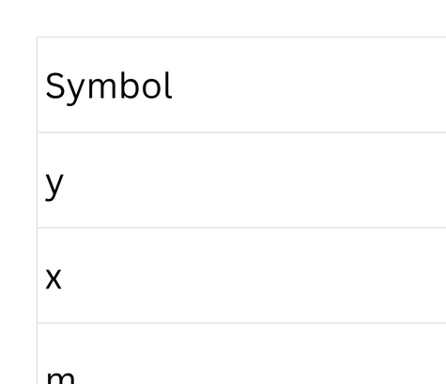
Let me draw the best straight line through these points.
y = mx + b
Prediction = slope × input + starting point
y = 10x + 25
(if 5 hours)
y = 10(5) + 25
= 50 + 25
= 75

Slide 14
Logistic Regression
Purpose: Performs binary or categorical classification (e.g., spam vs. not spam).
How it works: Uses a logistic or sigmoid function to map linear combinations of input features to probabilities between 0 and 1.
Best used for: Linearly separable classification problems requiring probabilistic outputs. [1, 2]
Linear Regression predicts HOW MUCH. Logistic Regression predicts WHICH CLASS. Hours studied → Pass / Fail

Slide 15
For example:
Student A → 0.15
Student B → 0.42
Student C → 0.78
Student D → 0.91
Then we use a threshold.
Usually:
Probability ≥ 0.5 → Class 1
Probability < 0.5 → Class 0
So:
0.78 → Pass
0.91 → Pass
0.15 → Fail
0.42 → Fail

Slide 16
DATA
↓
Initial Weight
↓
Make Prediction
↓
Compare with Actual
↓
LOSS
↓
GRADIENT
↓
"Change weight this way"
↓
Update Weight + Bias
↓
Make Prediction
↓
...
↓
FINAL WEIGHTS 🎯

Slide 17
Naive Bayes
Purpose: Handles fast text and categorical classification (e.g., sentiment analysis, document sorting).
How it works: Applies Bayes' Theorem of probability while making a "naive" assumption that all input features are conditionally independent of one another.
Best used for: High-dimensional datasets like text data where feature independence holds reasonably well

Slide 18
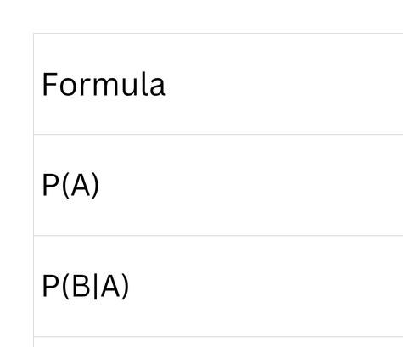
P(A|B) = P(B|A) × P(A)
----------------
P(B)
Probability of A after seeing B = probability of seeing B if A is true × probability of A, divided by probability of seeing B.

Slide 20
K-Nearest Neighbors (KNN)
Purpose: Executes non-parametric classification and regression.
How it works: An instance-based "lazy learner" that stores the training set and predicts a label by finding the K closest data points using a distance metric like Euclidean distance.
Best used for: Small to medium, clean datasets with non-linear decision boundaries where no explicit training phase is desired

Slide 21
